Slide 1

Outline
I. Movement prediction
How can co-actors predict and adapt to each others’ actions when online perceptual feedback is unavailable?
II. Strategic adaptation
Do co-actors modulate their action generally to support coordination?
III. Monitoring joint actions
Do co-actors monitor their own, their partner’s and / or the outcome of their combined actions?

Slide 2
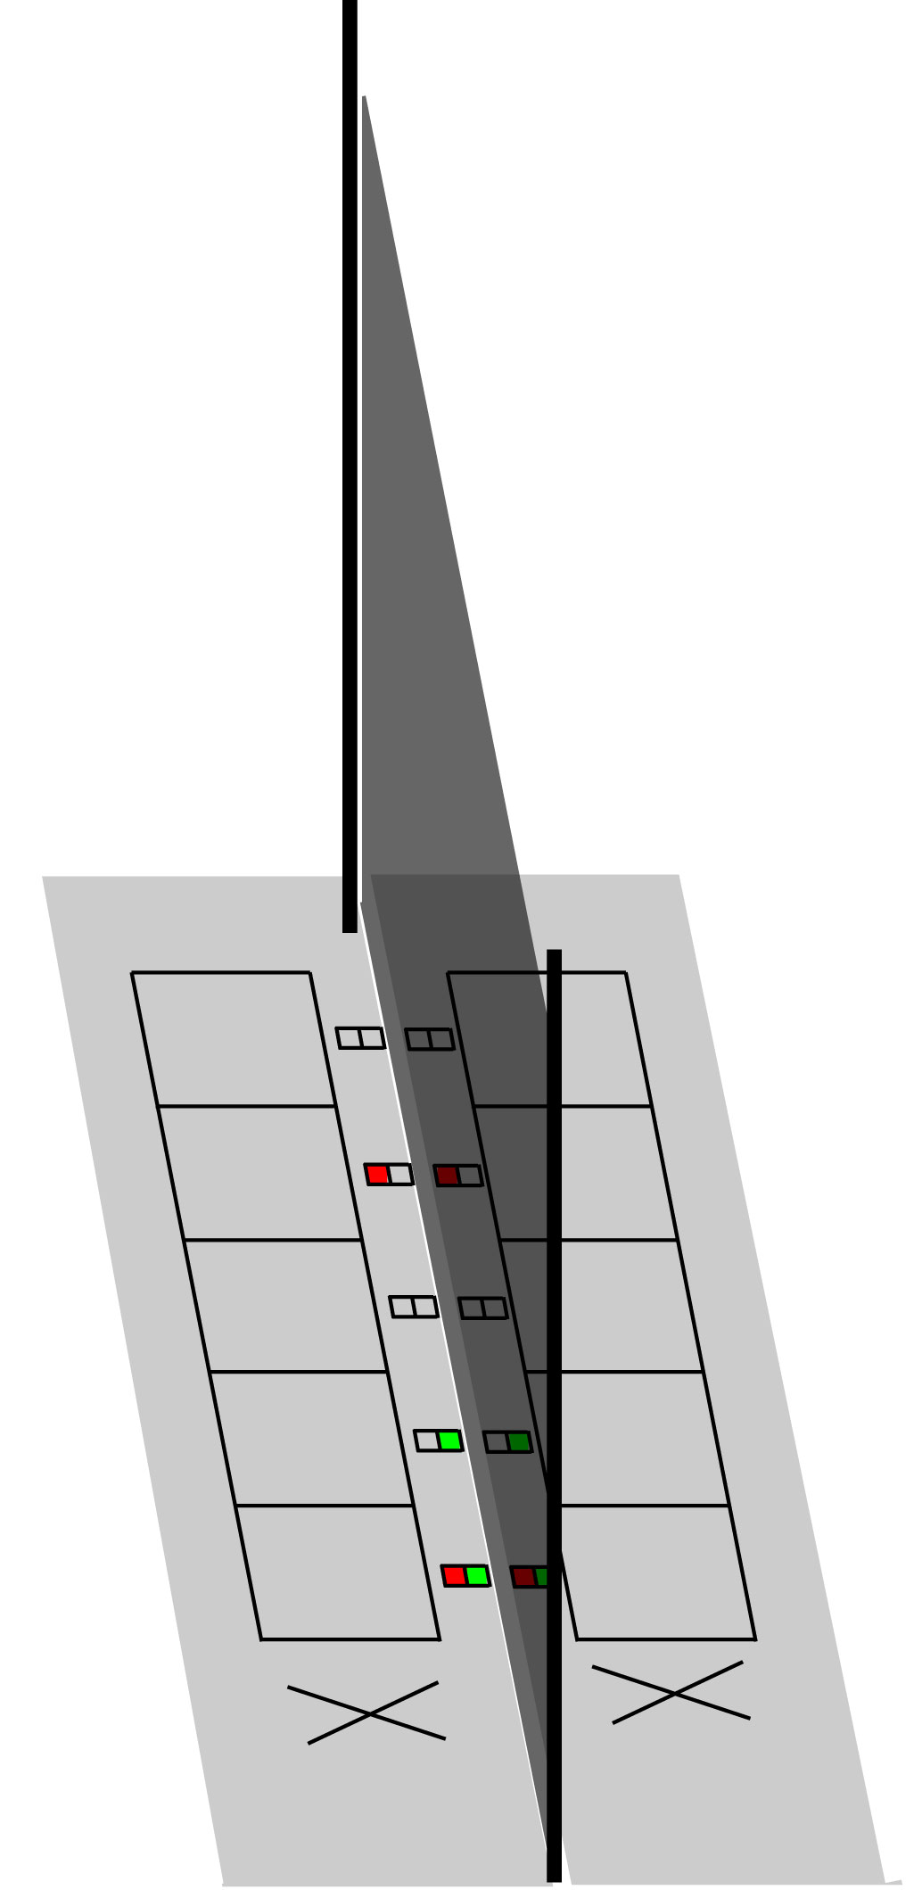
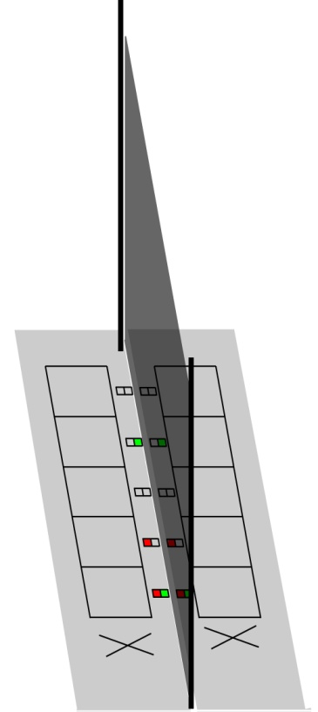
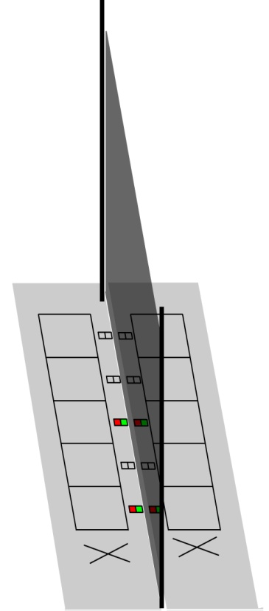

Movement Prediction
Joint jumping
Task: “Land at the same time!”
2-camera Optotrak system
Pressure-sensitive contact mats
140 cm
105 cm
70 cm
35 cm
Closer Same Farther
Farther Same Closer

Slide 3
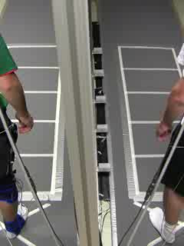
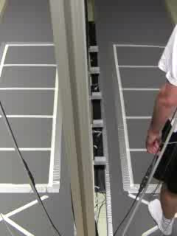
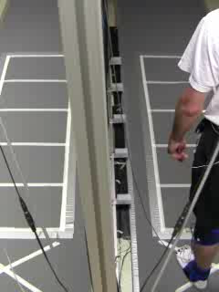
Movement Prediction
Joint
Individual unipedal
Individual bipedal

Slide 4
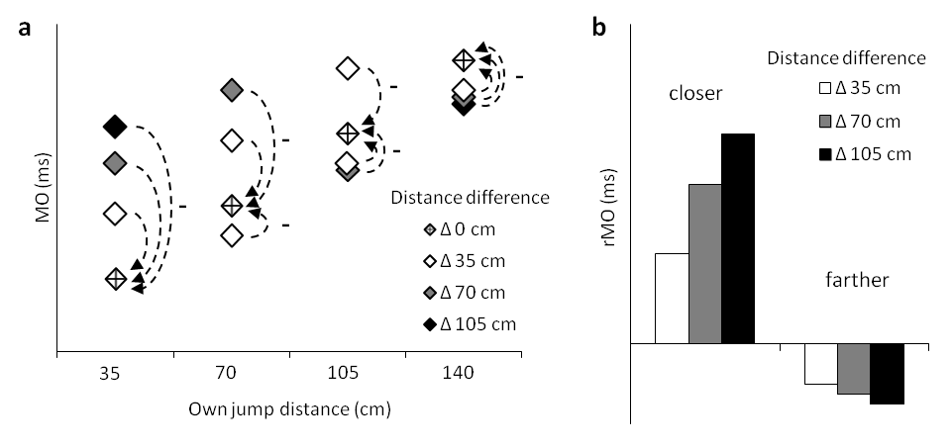
Movement Prediction
Data analysis

Slide 5
Movement Prediction
Adaptation to partner’s jump distance
However, no adaptation when own jump farther
Same pattern in individual bipedal coordination (at least in jump preparation)
No modulation in individual unipedal
Vesper, van der Wel, Knoblich, & Sebanz, in press, JEP-HPP

Slide 6
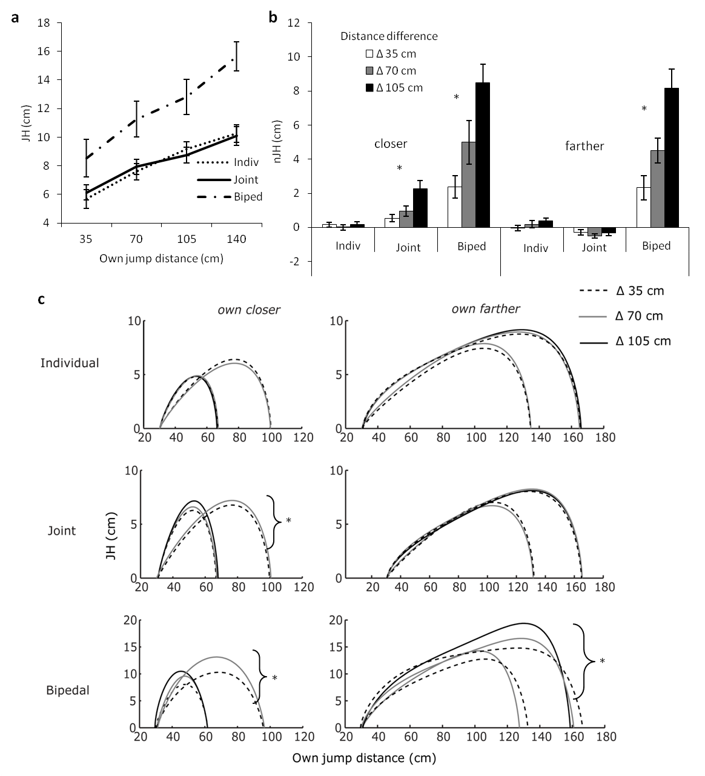
Movement Prediction
Individual unipedal
Joint
Individual bipedal
Vesper, van der Wel, Knoblich, & Sebanz, in press, JEP-HPP

Slide 7
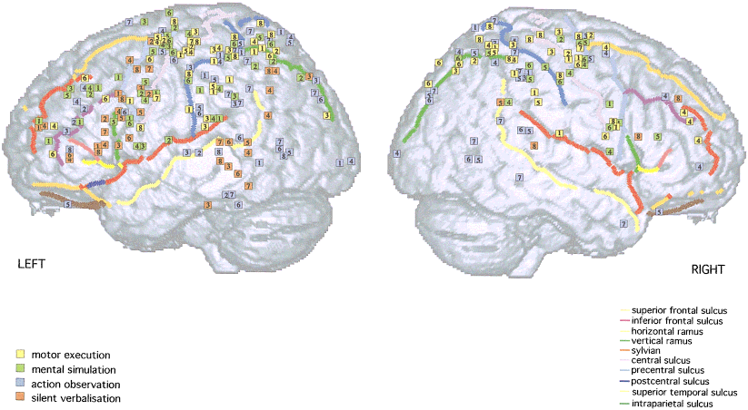
Movement Prediction
Can these findings be replicated and extended in a motor imagery task?
Motor imagery
Similar brain networks in action execution, observation and imagery (e.g., Grèzes & Decety, 2001)
Inolves action simulation (e.g., Jeannerod, 2001)
Temporal action characteristics often preserved in imagery (e.g., Shepard & Metzler, 1971; Decety et al., 1989)
(Grèzes & Decety, 2001)

Slide 8
Movement Prediction
Joint jumping imagery
Task: “Imagine to jump while landing at the same time as another person on the other side of the occluder!”
Response with button presses
Imagine experimenter as co-actor

Slide 9
Movement Prediction
Experiment 1
Adaptation to imagined partner’s jump distance
However, no adaptation when own jump farther
Replication!

Slide 10

Movement Prediction
Do common motor laws hold for imagery of joint action?
Fitts’ law:
Movement times predicted by ID and not by distance or target width alone (Fitts, 1954)
However, violation of Fitts’ law in ballistic movements (e.g., jumping) (Juras et al., 2009)
Hypothesis:
Integration of this violation in imagery of interpersonal coordination

Slide 11
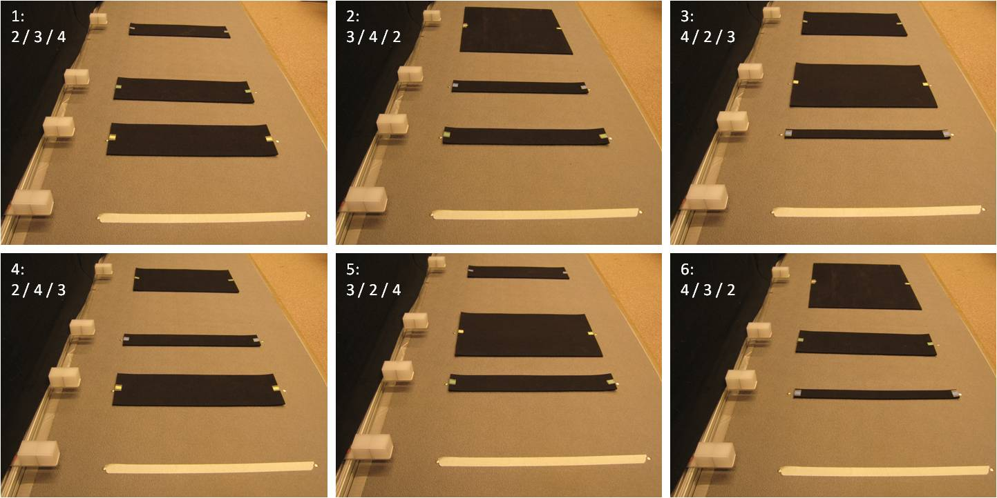
Movement Prediction
Imagery task manipulating both distance and index of difficulty (ID)
D
 | 28 | 56 | 140
3.5 | 4
7 | 3 | 4
14 | 2 | 3 | 4
28 |  | 2 | 3
56 |  |  | 2
W

Slide 12
Movement Prediction
Experiment 2: Distance
Same pattern (as expected)

Slide 13
Movement Prediction
Experiment 2: Index of difficulty (ID)
ID not taken into account for imagery of joint action

Slide 14

Movement Prediction
Intermediate summary: Movement prediction
Coordination of actions without online perceptual feedback possible by adapting one’s own action based on specific information about partner’s task
→ Integration of predictive models
Common motor laws of action execution taken into account for (imagery of) interpersonal coordination

Slide 16
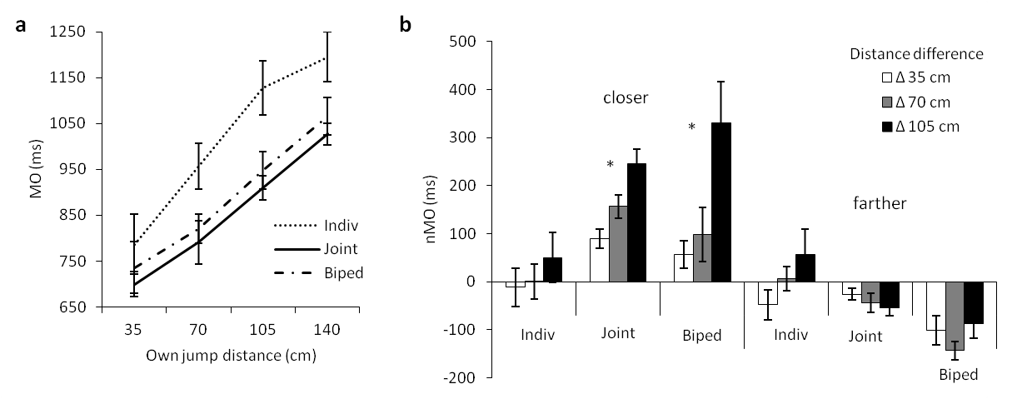
Results: Movement preparation

Slide 17
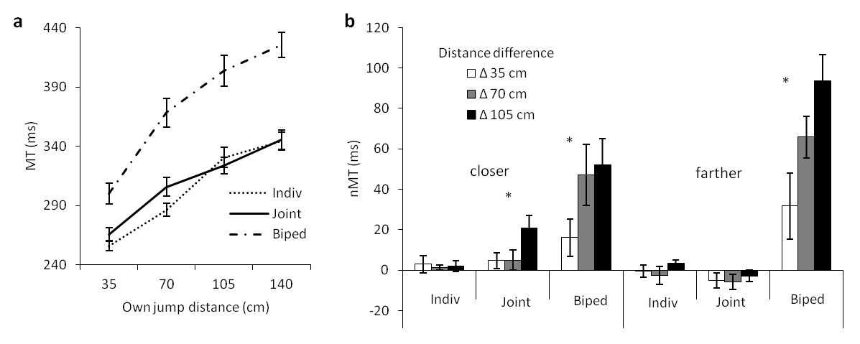
Results: Movement execution

Slide 18
Results: Movement execution

Slide 20
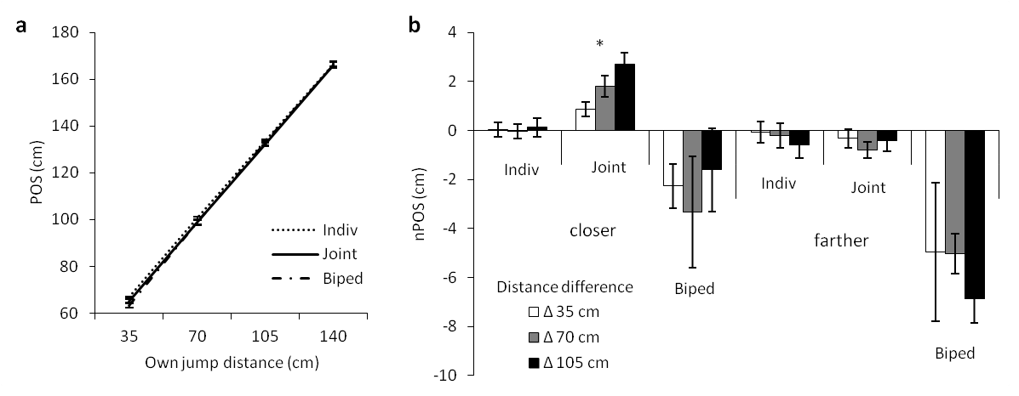
Results: Movement execution

Slide 21
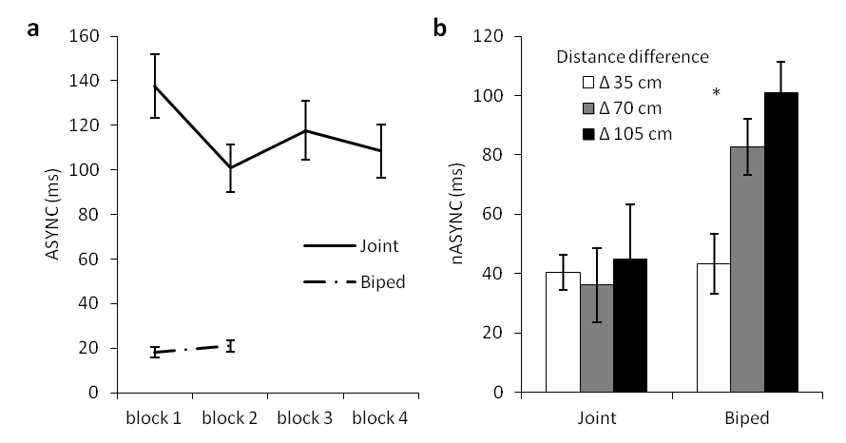
Results: Coordination performance

